Slide 1
Corey Haim
Falling star
By:
Emilee Hicks
&
Mattie Adams

Slide 2
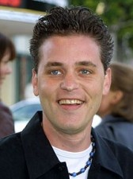
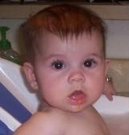
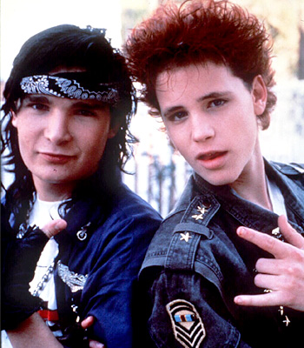
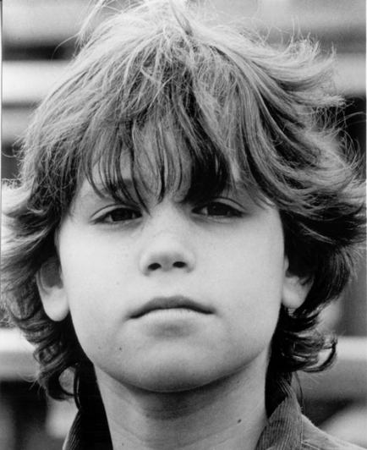
Early Childhood
Corey Haim was born on December 23, 1971 to Julia and Bernie Haim in Canada. While he was growing up Corey liked to play hockey, he wanted to eventually become a professional hockey player. As a child he was always the one that stood out to other people.

Slide 3
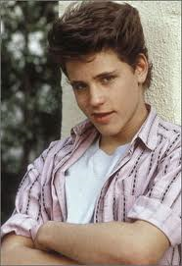
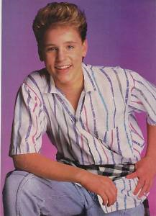
Adolescence
When Corey Haim was in his teenager years he loved to play hockey. He was so good at playing hockey he was on the path to the pro’s. Corey had so much potential; he was the perfect teenage boy he had the looks and the sports skills.

Slide 4
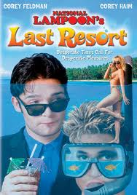
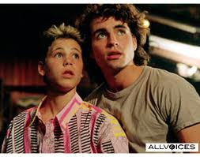
Career start
Corey’s career started with him going with his sister to her audition and they picked him over her. His first gig was with the show called the Edison twins, and then the movie first born. Only a year after, first born, he was slated for four more films, everyone saw how much potential he had in the film industry

Slide 5
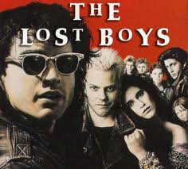
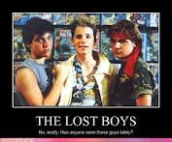
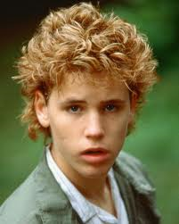
Career High
Corey Haim was a teenage idol when he started in the movies Lucas, and the lost boys. On his way to fame though, he got side tracked by drugs that would break this teenage star.

Slide 6
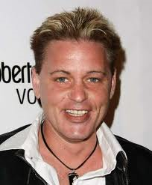
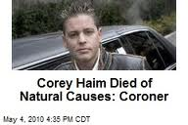
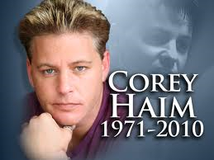
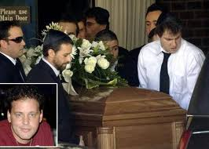
Death
Corey Haim died on March 10, 2010 at the age of 38. The first reaction was that he died due to drugs but the real reason was natural causes. The drugs did take a toll on this teenage star so his body was not strong enough to fight the infection.

Slide 7
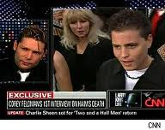
Public Reaction
Everyone loved Corey Haim they could never forget the few amazing films he did as a teenager. He was trying to make a comeback, but his life was taken before he could get his break. Corey Feldman was his best friend they even had a series “the two Corey’s.” when he died Corey Feldman stated, “this is a tragic loss of a wonderful, beautiful, tormented soul, who will always be my brother, family, and best friend.”
Corey you were a Brilliant Light whose flame will never be extinguished
Adrianne Curry: Corey Haim died.That is what happens when u cant grow the f--- up&kick the habit.sadly,most who start dont stop.A waste of beautiful life :(
Nick Zano: Corey Haim. This is a dangerous industry it plays w ur head & sadly he lost, u have 2 b happy w u & that goes w any profession. U define u.
Ashton Kutcher: Rip Corey Haim "Childhood hero"

