Slide 1
Jim Morrison
The Poet
Born in December 8th 1943 in Melbourne Florida

Slide 2
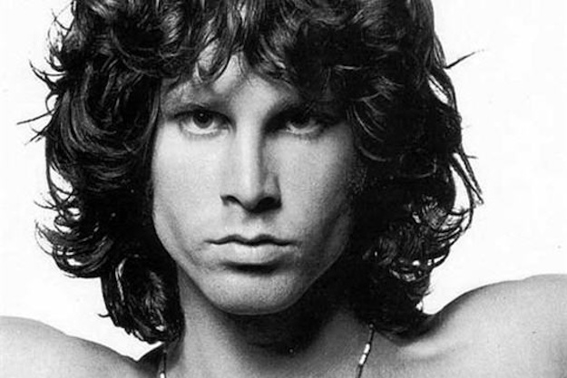
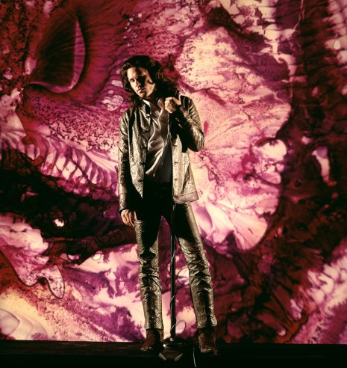
Jim Morrison

Slide 3
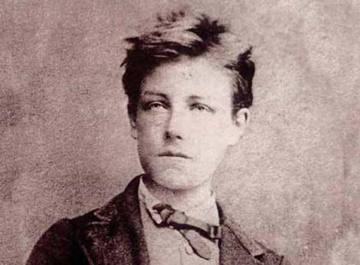
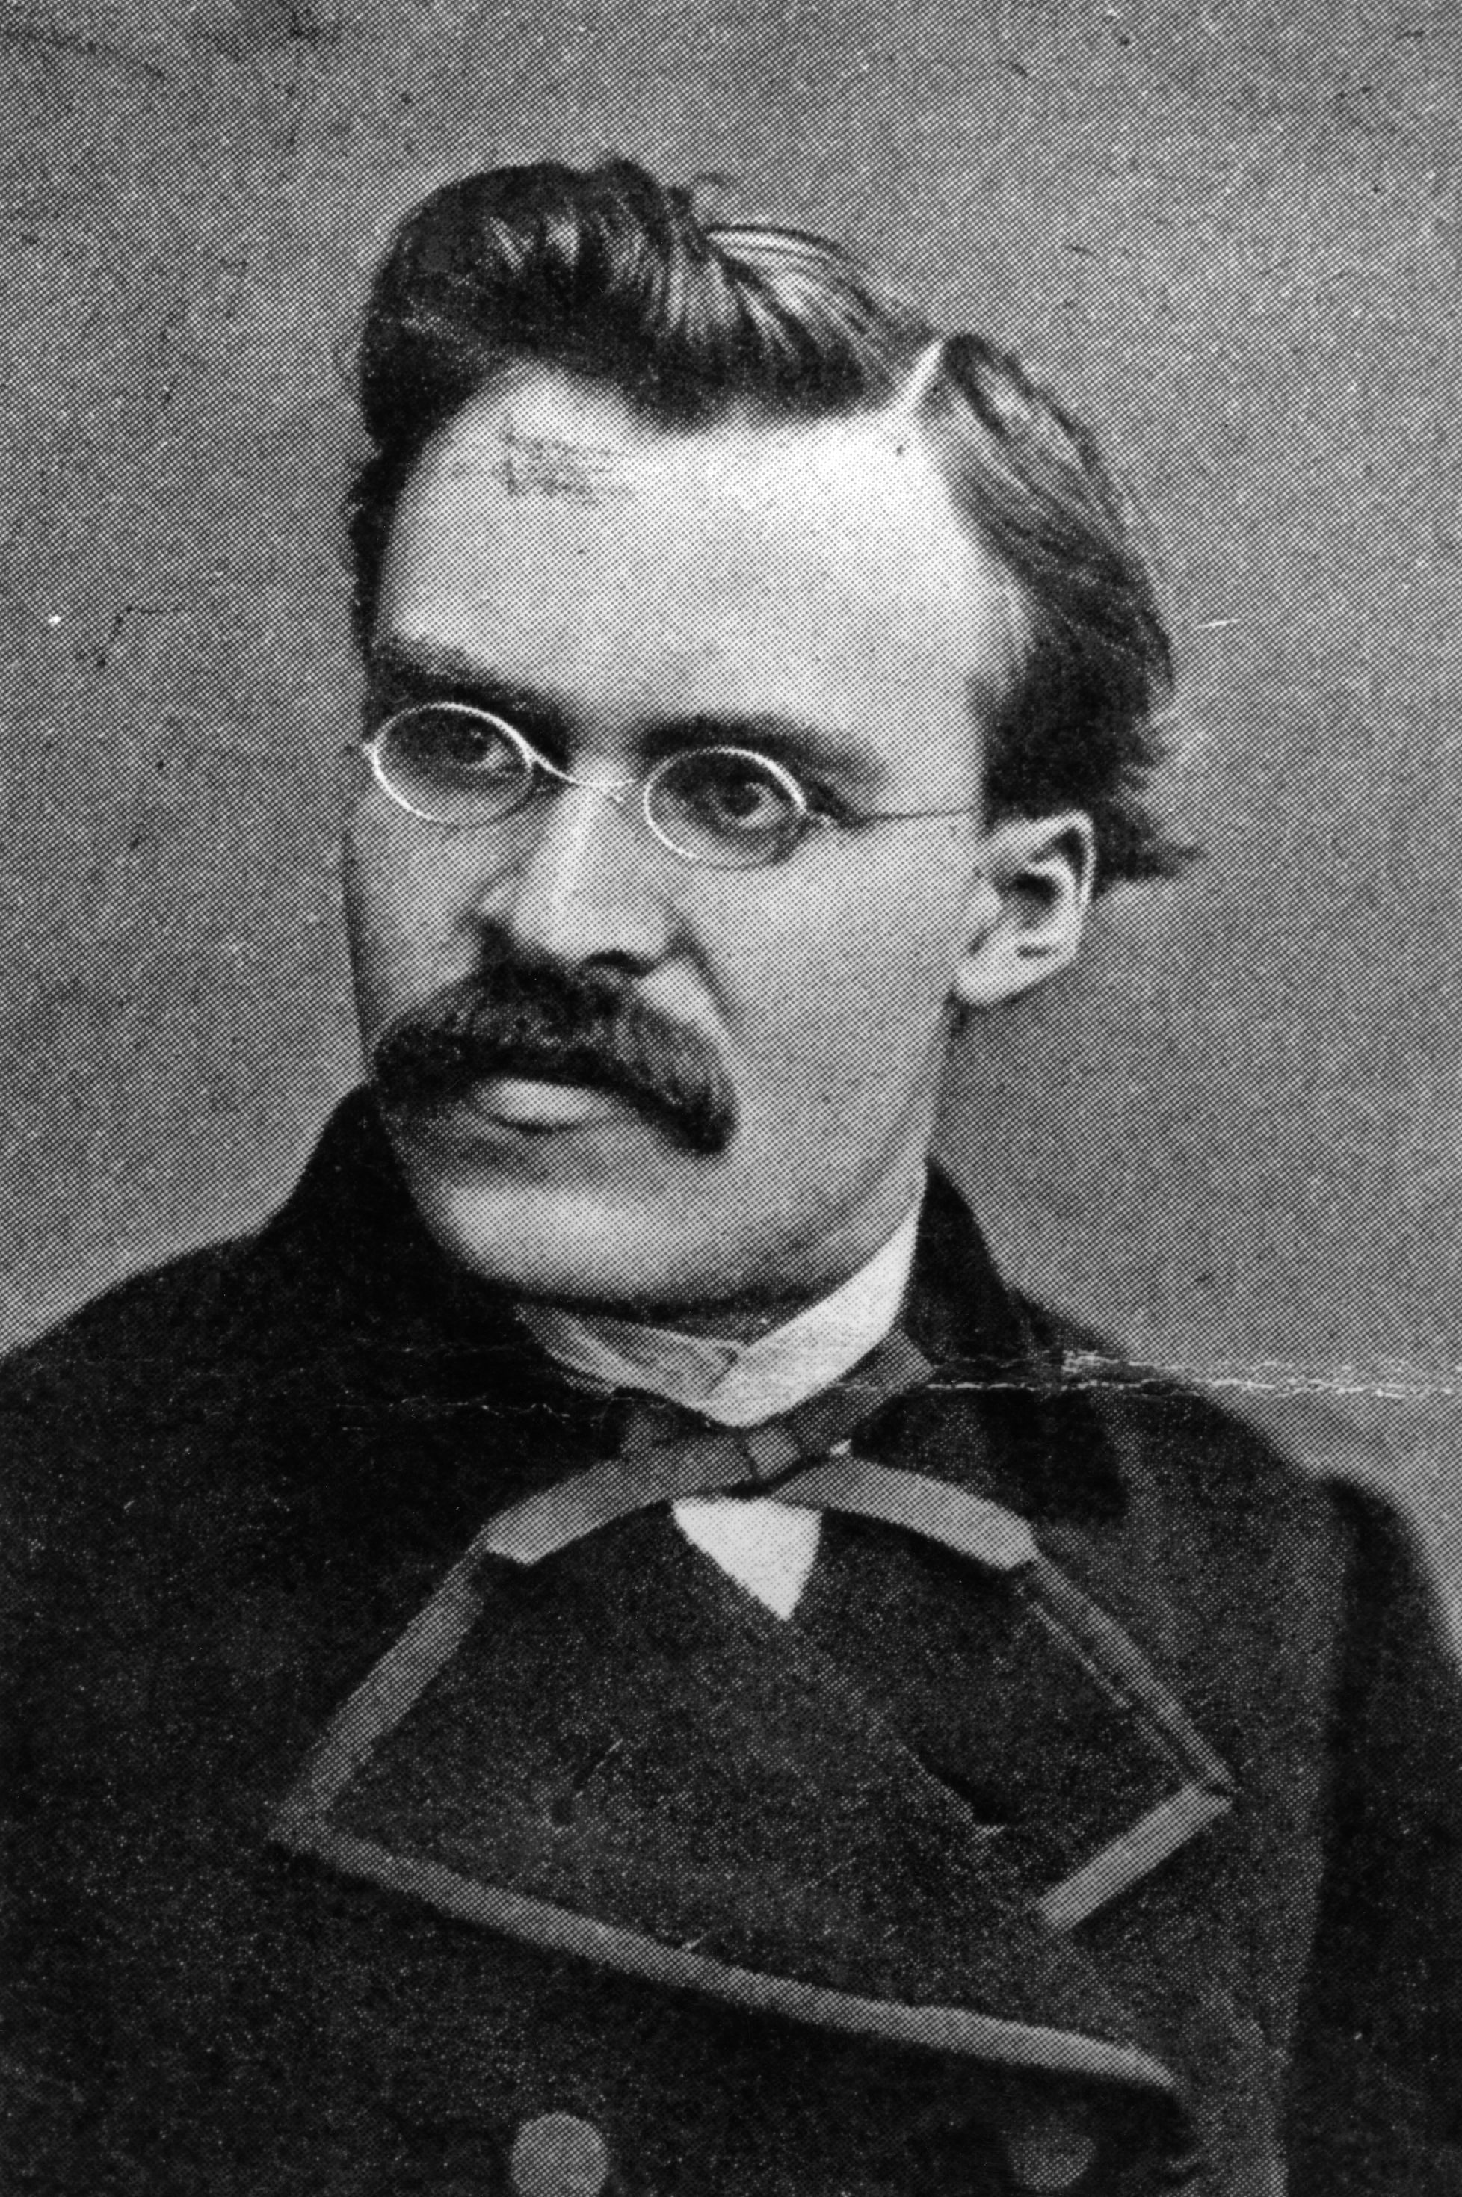
Arthur Rimbaud, Friedrich Nietzsche
Jim was widely inspired by this authors.

Slide 4
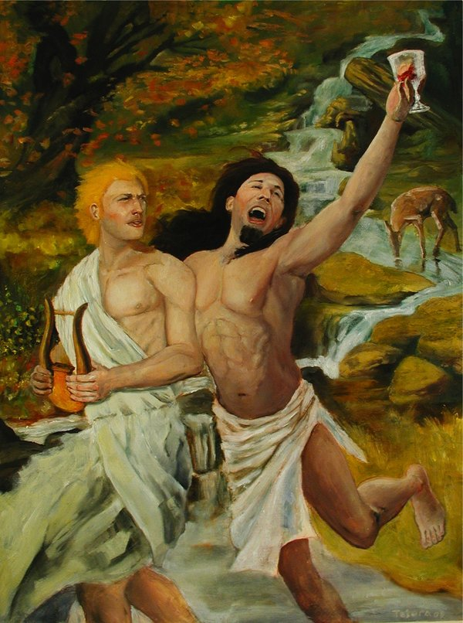
Jim Morrison was into Greek Mythology. Apollo who is the god of the sun and is associated with dreams and reason and Dionysus, who is the god of wine, ecstasy and intoxication.

Slide 5
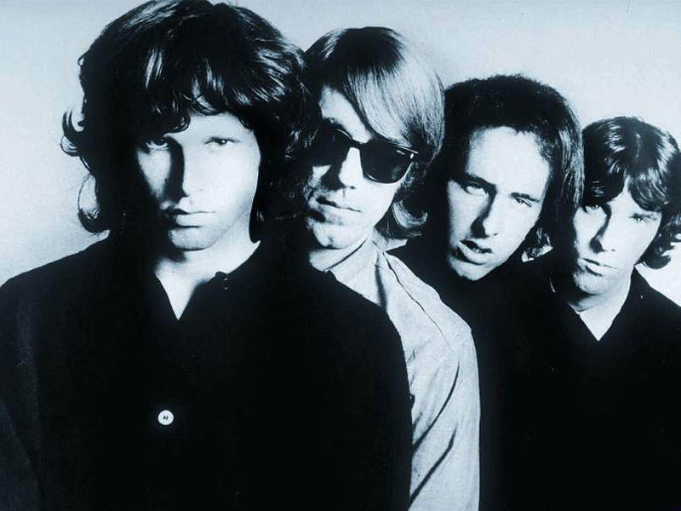
In 1960, The Doors was birthed

Slide 6
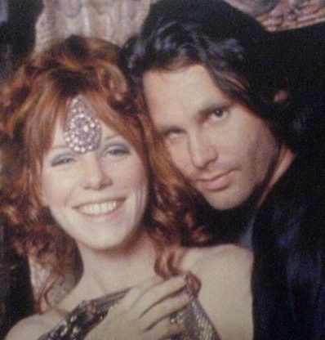
Jim and his girlfriend, Pamela Courson

Slide 7
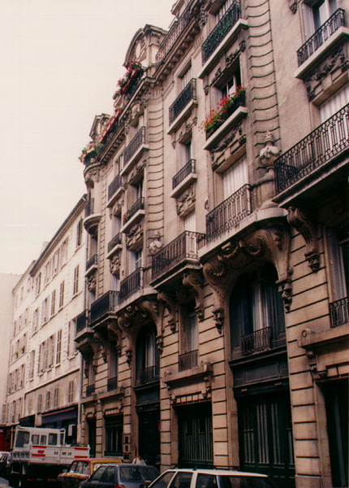
Jim’s apartment in Paris
Notes:
.

Slide 8
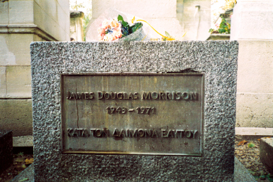
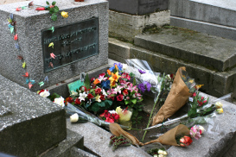
Inscription on Jim’s grave, ΚΑΤΑ ΤΟΝ ΔΑΙΜΟΝΑ ΕΑΥΤΟΥ, meaning ‘True to His own Spirit’.

Slide 9
The end!

