Slide 1
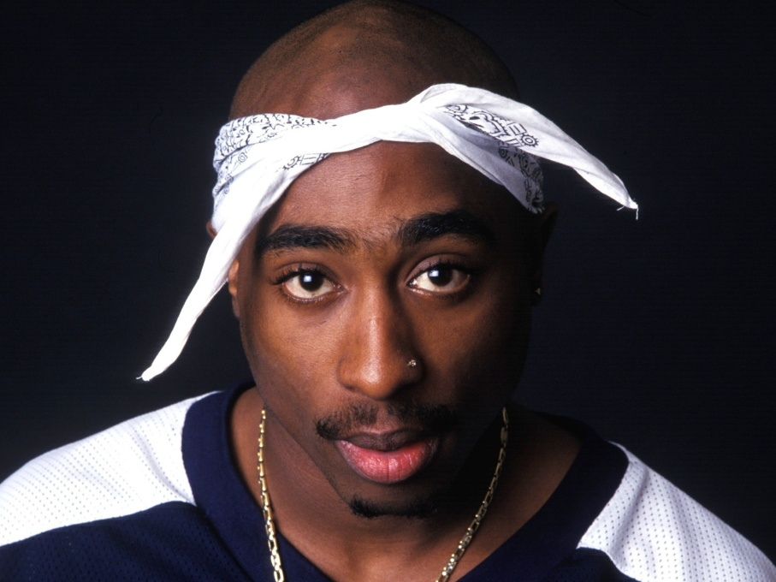
Tupac Shakur: The Complete Legend
By: Trey Petty

Slide 2
Legend
The word Legend is defined as: A story sometimes popularly regarded as history but unauthorized. It is also defined as: An extremely famous or notorious person.
The Legend

Slide 3
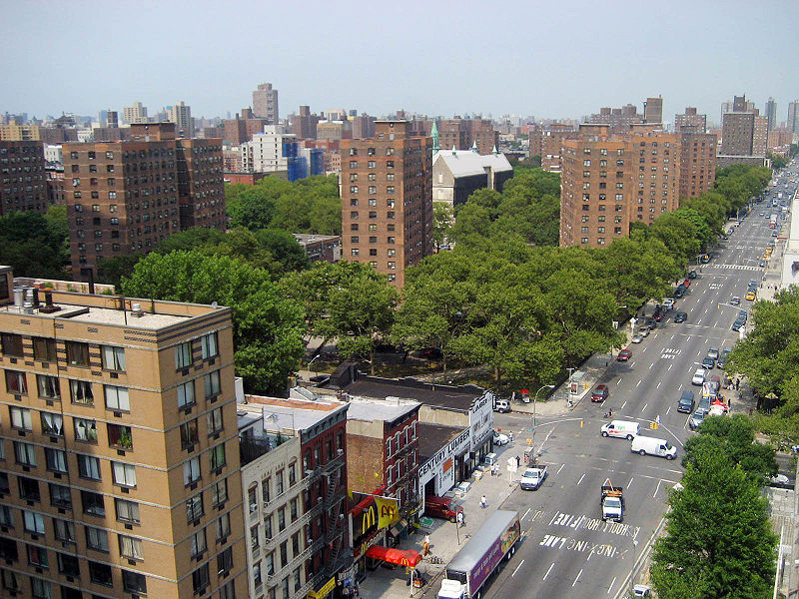
Tupac was born June 16, 1971
He was born in East Harlem in Manhattan, New York.

Slide 4
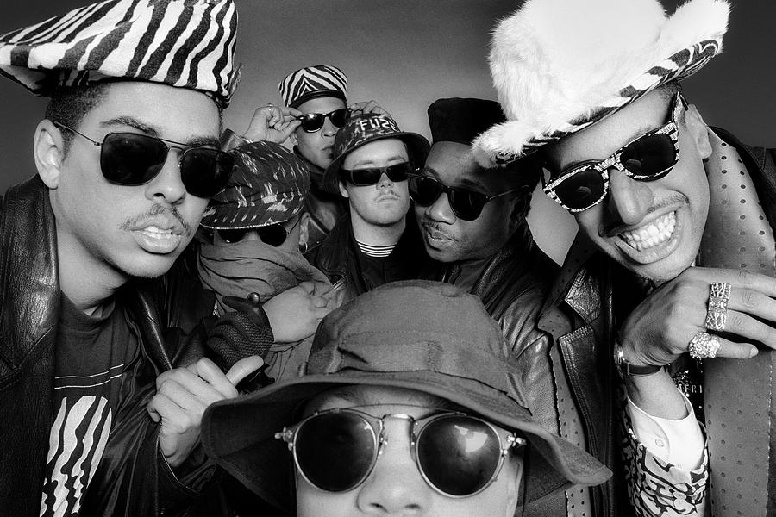
He didn’t start as a solo artist.
He started out his career with the musical group, Digital Underground

Slide 5
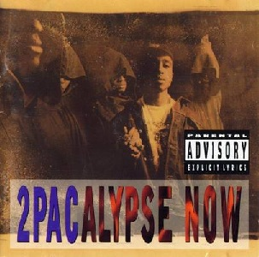
His first solo album was 2Pacalypse Now
This album didn’t start out big, but is now considered one of the best

Slide 6
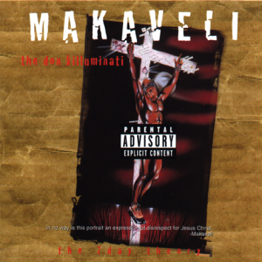
His last, but biggest album was: the 7 day theory
Ranked 9th of the biggest hip hop albums of all time
664,000 copies sold within the first week, making it the second biggest first week of sales ever

Slide 7
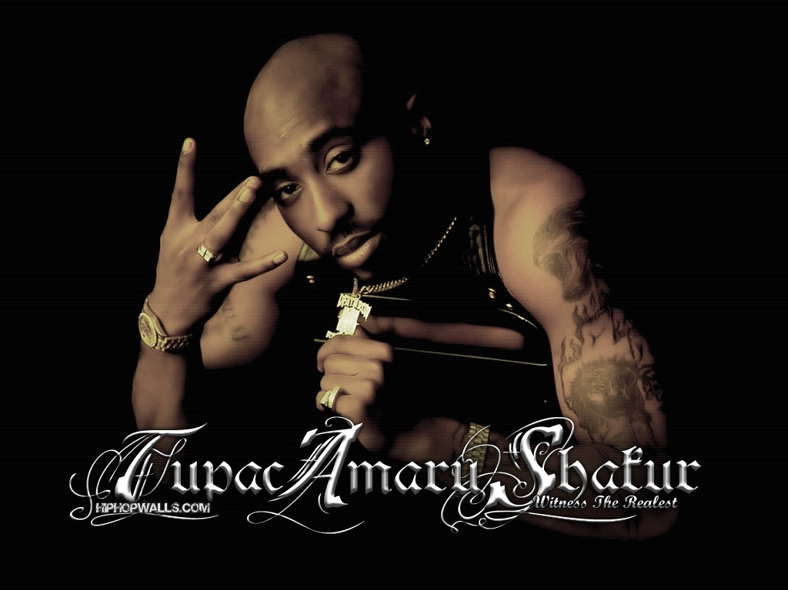
So why was he so big?
Some say it was his life style
It could be the stunts he pulled
Many liked how he tried to make rap more of an art form

Slide 8
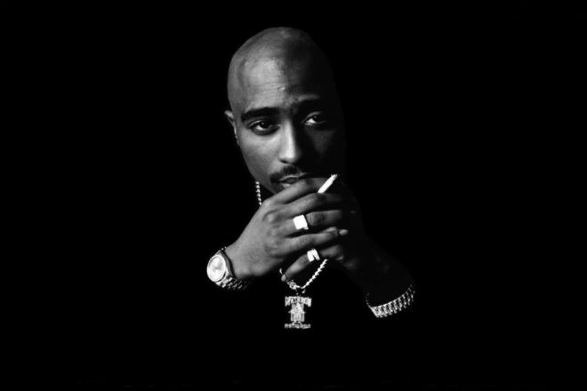
Tupac died on September 13, 1996
After watching a boxing match with his group, they began to drive around the city
This was on September 7
While driving Tupac and his group were involved in a drive by shooting
Tupac Died 6 days later

Slide 9
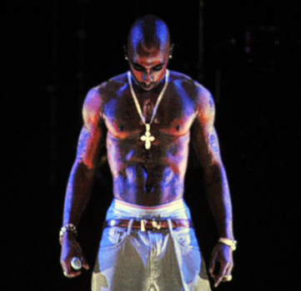
Tupac is still making history and selling albums today
He continues to be considered the best gangster rapper ever
He even performed 16 years after his death as a hologram performance

Slide 10
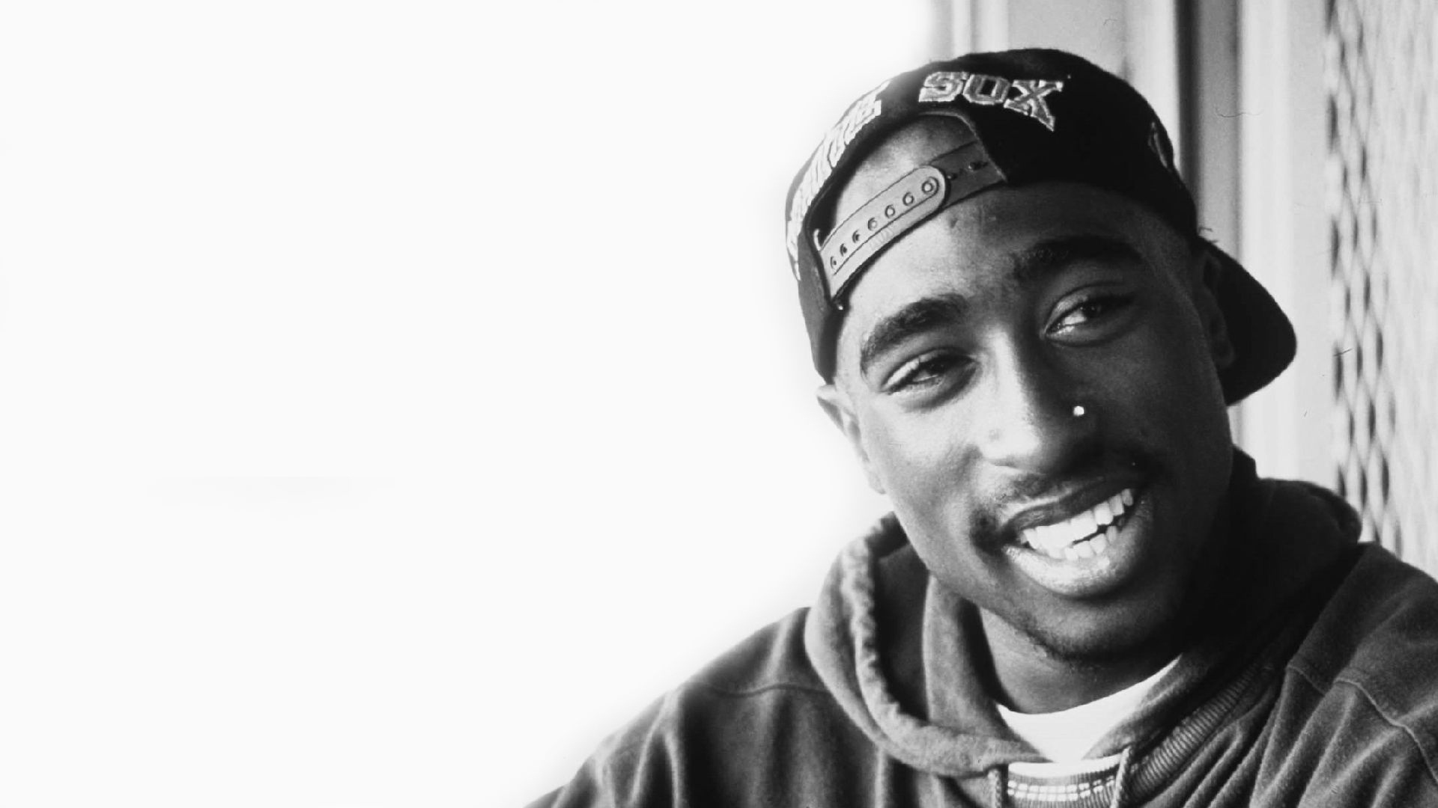
Rest in Peace
Tupac Shakur 1971-1996

