Slide 1
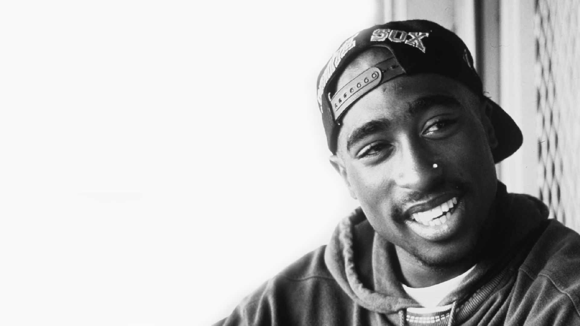
Tupac Shakur
By: Lauran Huey
English 1301
1 PM

Slide 2
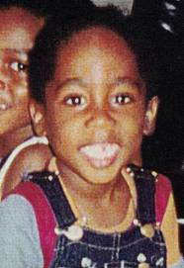
Tupac was born on June 16th 1971 he was born and raised in New York
As a child Tupac spent most of his time by himself, because his father was absent and his mother was addicted to drugs
In 1984 Tupac moved to Baltimore at the time Baltimore was known to have the highest rate of teen pregnancy, and AIDS

Slide 3
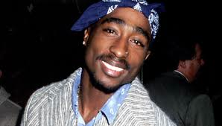
Tupac’s first development was in 1991 he was a member of the group Digital Underground
That same year he, also received recognition for his album called “2Pacalypse Now”
In 1992 he starred in movie called “Juice,” and in 1993 he co-starred with Janet Jackson in “Poetic Justice.”
In 1994 Tupac was guilty of sexual assault he was sentenced to one and half to four year in jail
In 1995 his album “Me Against The World” headed towards the top of the charts. After, serving eight months in jail Tupac was released, and in late 1995 he signed a contract with Death Row.

Slide 4
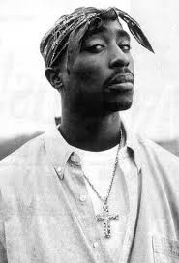
On September 13, 1996 at the University of Nevada Medical Center in Las Vegas at the age of 25 Tupac Shakur had died
Four bullets hit Tupac on September 7th, 1996 as he was driving towards the Las Vegas strip. Six days later Tupac died from respiratory failure, and cardio-pulmonary arrest, Tupac had his right lung removed, and shortly after he went into coma.

